Slide 1



IOT BASED SMART ENERGY METER
.
page 01

Slide 2

MEET OUR TEAM
M. Jayadharsini
230701127
Dharshini R S
230701076
Hemashri U
230701114
page 02

Slide 3

OBJECTIVES
In an era of rising electricity costs and energy conservation, smart monitoring is the key to efficient power management.
This project introduces an intelligent energy tracking system that provides real-time insights, helping users monitor and optimize their electricity usage effortlessly.
By analyzing consumption patterns and sending timely alerts, the system ensures users stay within limits, preventing overuse and extra charges.
With a focus on energy efficiency and cost reduction, this solution encourages smarter consumption for a more sustainable and responsible future.
page 03

Slide 4






EXISTING
SYSTEM
VS
PROPOSED
SYSTEM
Limited or delay data updates
REAL-TIME POWER
MONITORING
Calculate power, voltage and current in real-time
No alert for high consumption
THRESHOLD - BASED ALERTS
Sends alert when power exceeds the threshold to avoid extra billing
Basic numerical readings or minimal graphs
GRAPH-BASED DATA
VISUALIATION
Interactive graphs on web application for easy monitoring
Users only see usage after billing
PROACTIVE
COST
SAVING
Alerts help users reduce consumption before exceeding expensive limits
page 04

Slide 5
LITERATURE
REVIEW
PAPER TITLE | AUTHOR | CONTEXT
Smart Energy Meter using IoT | X. Yu, Z. Zhang, and L. Li, | This paper proposes an IoT-based smart energy meter using sensors and a NodeMCU to monitor electricity in real-time, upload data to cloud platforms like ThingSpeak, and alert users on excessive usage for better efficiency and billing transparency.
Design and Development of Smart Energy Meter with Advanced Billing System | A. Kumar, P. Gupta, and R. Sharma | This paper introduces an IoT-enabled smart energy meter that uses NodeMCU and sensors for real-time electricity monitoring, cloud-based data logging, and alerts to enhance energy efficiency and billing accuracy.
IoT Enabled Smart Energy Meter for Efficient Energy Utilization | R. Verma, S. Kumar, and N. Kaur | This study presents an energy meter using ESP8266 with current and voltage sensors, connected to Blynk for live mobile visualization and alerts to promote user awareness and energy conservation.
page 05

Slide 6

PROPOSED SYSTEM
The proposed system is an IoT-based smart energy meter designed to monitor real-time power consumption and provide users with actionable insights. It enables efficient energy management by offering remote monitoring, usage alerts, and data visualization, helping users optimize electricity consumption and reduce wastage.
Flow of the Smart Energy Meter System:
1. Data Acquisition The current sensor (ACS712) captures real-time electricity consumption.
The ESP32 Wroom microcontroller processes the raw data.
2. Data Transmission The processed data is sent to the cloud platform via Wi-Fi.
3. Data Processing & Storage The cloud system stores and analyzes the consumption data.
It detects patterns and determines if usage exceeds set limits.
4. User Notification & Visualization If consumption is nearing or exceeding limits, an alert is triggered.
Data is displayed graphically on a web/app dashboard for real-time monitoring.
page 06

Slide 7

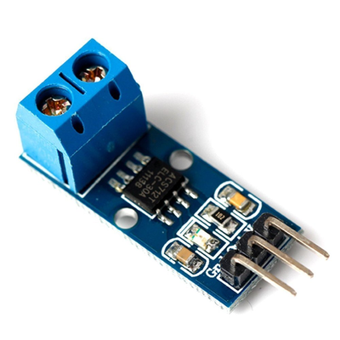
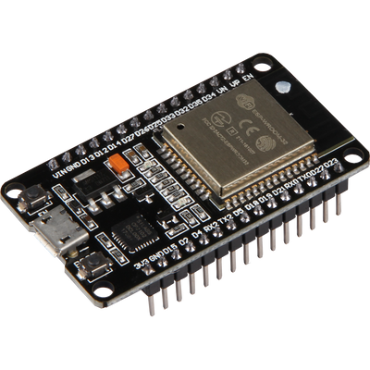
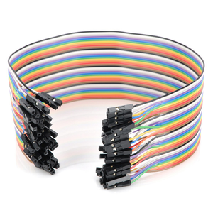
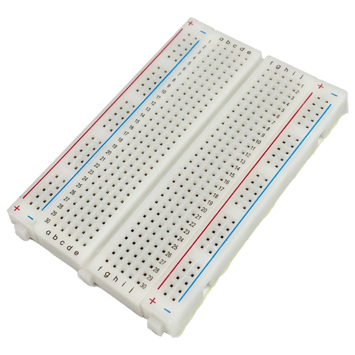
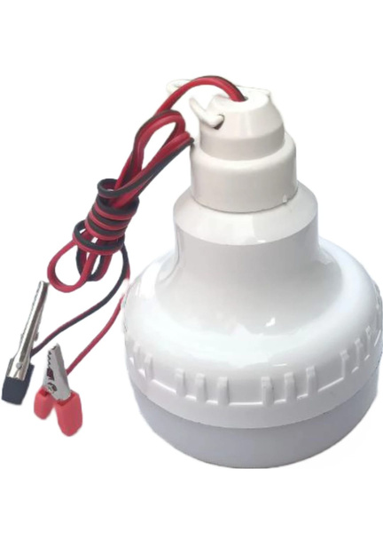

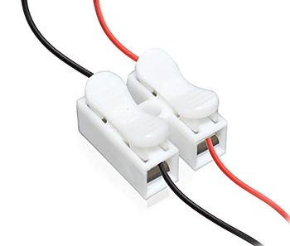
COMPONENTS
ACS 712
(30A Current Sensor)
ESP32 (WROOM)
Jumper Cables
Breadboard
Copper Wire
2-Way Push Wire Connector
12V DC Light
page 07

Slide 8

MODULES
1.
2.
3.
Data Logging & Cloud Storage Module
Power Consumption Calculation Module
Real-Time Current Sensing Module
Current readings with timestamps are logged in a CSV file and uploaded to Google Drive automatically, ensuring safe cloud storage and easy access.
The stored data is processed to compute power and cumulative energy usage, allowing accurate monitoring of electricity consumption over time.
This module uses the ACS712 sensor with ESP32 to measure current in real time. The data is sent to the system via serial communication for further processing.
4.
5.
Visualization Module
Threshold Monitoring & Alert Module
Current vs Time graphs are generated in real time to help users visually track usage patterns and identify peak consumption periods.
A preset threshold is used to detect overconsumption. When the limit is crossed, an alert is triggered to notify the user instantly.
page 08

Slide 9
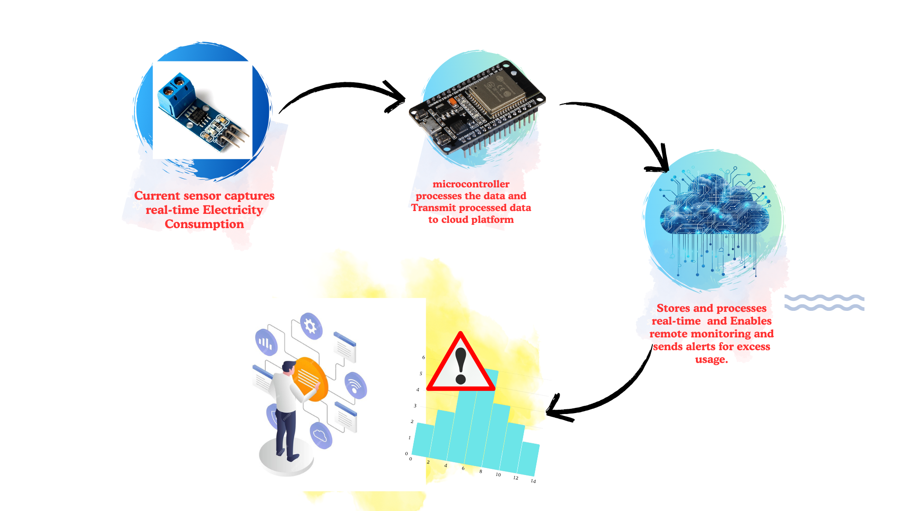
DESIGN METHODOLOGY
page 09

Slide 10
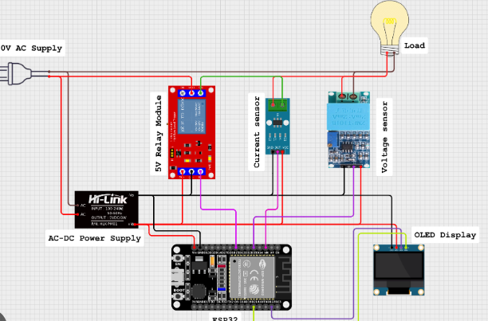
System Architecture
page 10

Slide 11

1.
Remote Control Integration
In the future, smart appliance control can be added to the system, allowing users to remotely turn off high-energy devices once their consumption crosses the threshold, helping prevent overuse.
FUTURE
ENHANCEMENT
2.
AI-Based Predictive Monitoring:
By integrating AI algorithms, the system could analyze historical energy patterns and provide intelligent suggestions or alerts to optimize energy consumption and reduce wastage.
page 11

Slide 12
REFERENCES
X. Yu, Z. Zhang, and L. Li, "Smart Energy Meter using IoT," Journal of Electrical Engineering & Technology, vol. 10, no. 3, pp. 202-210, 2018.
A. Kumar, P. Gupta, and R. Sharma, "Design and Development of Smart Energy Meter with Advanced Billing System," Energy Reports, vol. 6, pp. 440-450, 2019.
R. Verma, S. Kumar, and N. Kaur, "IoT Enabled Smart Energy Meter for Efficient Energy Utilization," Journal of Renewable Energy & Smart Grids, vol. 8, no. 2, pp. 115-120, 2020.
R. Saini, R. Goyal, and A. Sharma, "AI-Based Smart Energy Monitoring System using Machine Learning Algorithms," International Journal of Energy Science, vol. 15, pp. 98-106, 2021.
M. Sharma, A. Desai, and P. Mehta, "Smart Meter with Cloud Connectivity for Home Automation and Energy Tracking," IEEE Transactions on Smart Grids, vol. 7, no. 5, pp. 678-685, 2020.
page 12

Slide 13
THANK YOU!

